Slide 1
Facial
Emotion Recognition
using Deep Learning
{
<Dauntless Odessey>
}
...

Slide 2
Table of contents
01
02
03
Dataset Management
Working procedure
Final Outcome

Slide 3
01
Introduction
{
..
}
..

Slide 4
Facial Emotion Recognition
*
The motivation behind this project lies in the potential applications of emotion recognition technology. By understanding human emotions, we aim to implement this system in a companion robot, enhancing human-robot interactions and fostering emotional intelligence.
Exploring Different CNN architectures
Collect large dataset
Microcontroller-based projects

Slide 5
02
Dataset Management
{
..
}
..

Slide 6
Facial Emotion Recognition
The participants whom we reached to take samples gave various expressions like happy, angry, sad, Neutral etc. There were approximately 100 participants who gave sample.
The labeled emotions on the sequences are:
1. Anger
2. Neutral
3. Disgust
4. Fear
5. Happiness
6. Sadness
7. Surprise
*

Slide 7
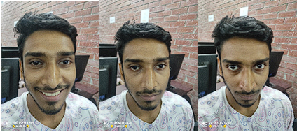
Facial Emotion Recognition
Sample collected from participant

Slide 8
03
Working Procedure
{
..
}
..

Slide 9
Methodology
...
Data Processing
Model Construction
Model Training

Slide 10
Data Processing
• Raw sample images are collected from diverse individuals to ensure a broad representation of facial expressions.
• Images are resized to a standard input size, and pixel values are normalized to the range [0, 1].
}
..

Slide 11
Code
label_dict = {'happy': 0, 'Sad': 1, 'Angry': 2}
labels = [label_dict[label] for label in labels]
labels = to_categorical(labels, num_classes=3)
}
..

Slide 12
Model Construction
• A Convolutional Neural Network (CNN) is constructed using the Keras Sequential model.
• The CNN architecture comprises convolutional layers, max-pooling layers, a flattening layer, and fully connected layers.
}
..

Slide 13
Code
model = Sequential()
model.add(Conv2D(32, (3, 3), activation='relu', input_shape=(48, 48, 1)))
model.add(MaxPooling2D((2, 2)))
model.add(Conv2D(64, (3, 3), activation='relu'))
model.add(MaxPooling2D((2, 2)))
model.add(Flatten())
model.add(Dense(128, activation='relu'))
model.add(Dropout(0.5))
model.add(Dense(3, activation='softmax'))
}
..

Slide 14
Model Training
• The model is trained using the limited dataset with 10 epochs.
• Python code is configured to execute the FER program.
}
..

Slide 15
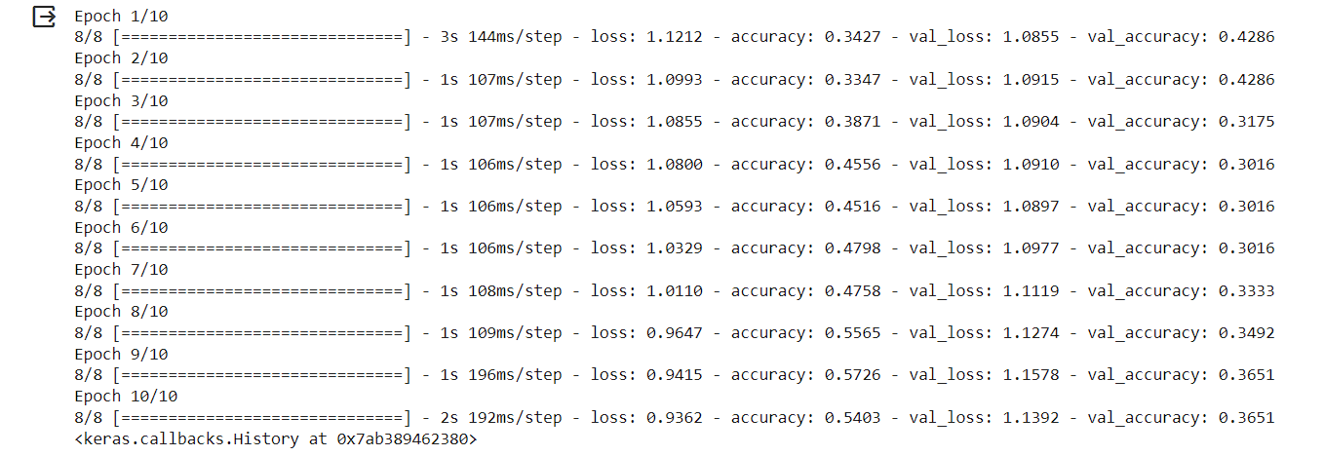
Code
model.compile(optimizer=Adam(), loss='categorical_crossentropy', metrics=['accuracy'])
model.fit(X_train, y_train, epochs=10, validation_data=(X_test, y_test))
}
..

Slide 16
Execution
Please visit:
GitHub
*

Slide 17
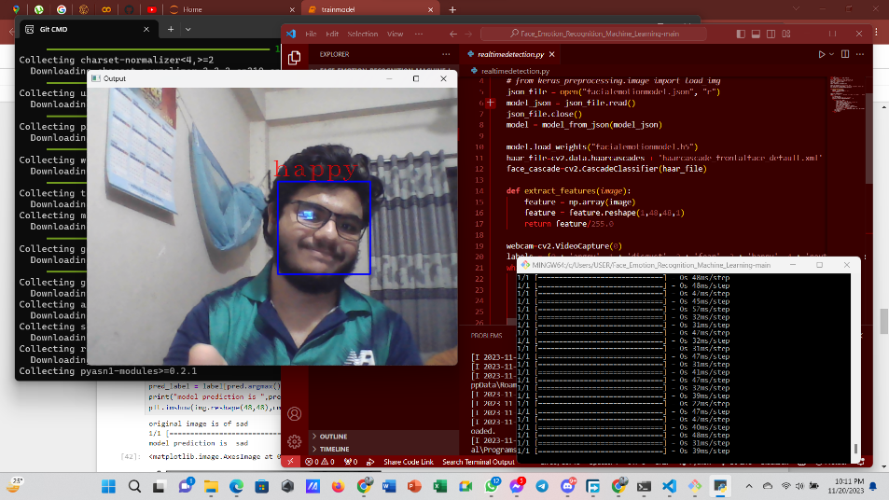
Final Outcome
{
The trained model achieves a moderate accuracy of 73% on the limited dataset
}
...

Slide 18
Future Work
Future work on this project could include:
• Using larger and more diverse datasets
• Exploring different CNN architectures
• Incorporating additional features such as facial landmarks
• Implementing on a microcontroller-based device.
}
..

Slide 19
Thanks!
< Do you have any questions? >

Slide 20
Team Members
{
Sultanus Salehin
ID: 221-15-5357
MD Arham Tabib
}
ID: 221-15-5707
*

